Slide 1

Arrays & Objects

Slide 2
Arrays (Massiv)
“an impressive display or range of a particular type of thing”
Dimensions
1,2,3, … n dimensions
Matrices

Slide 3
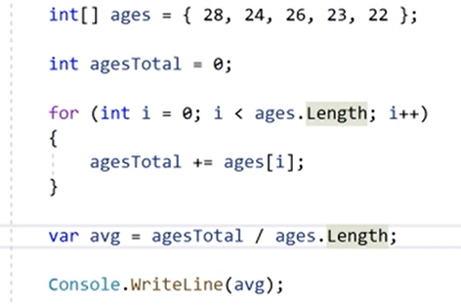
Use of Arrays

Slide 4
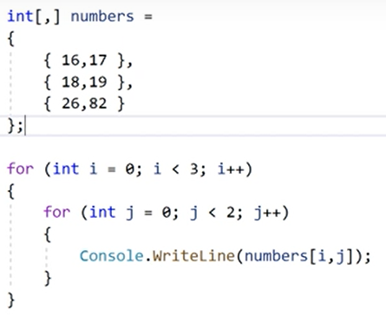
Multidimension & Nested Loops

Slide 5
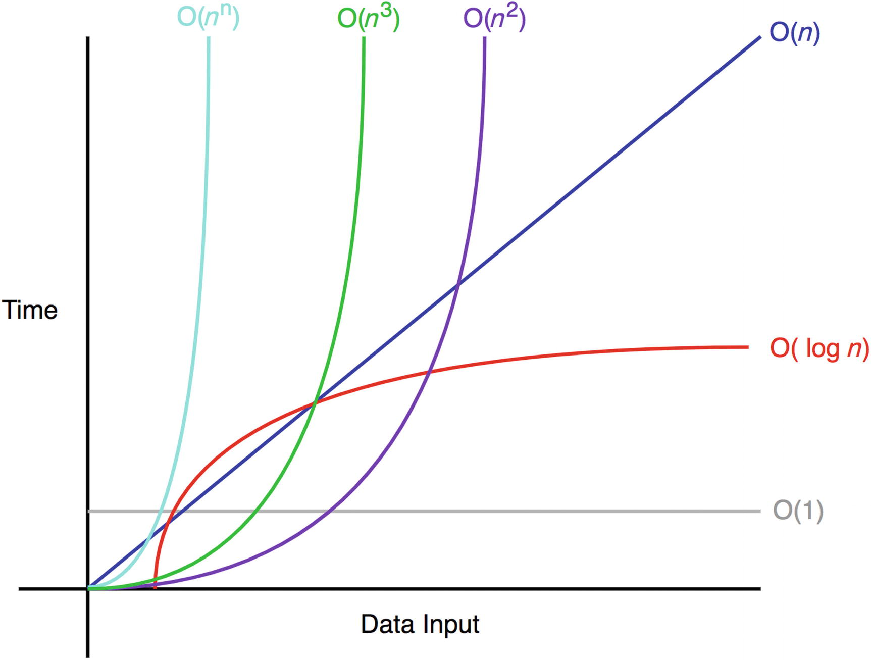
Time complexity - Big O notation
Notes:
https://betterprogramming.pub/big-o-notation-for-dummies-like-me-98ac2d141f9f
https://www.freecodecamp.org/news/all-you-need-to-know-about-big-o-notation-to-crack-your-next-coding-interview-9d575e7eec4/
https://www.geeksforgeeks.org/searching-algorithms/
https://www.cs.usfca.edu/~galles/visualization/Search.html

Slide 6
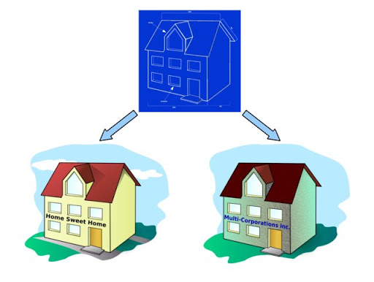
Object & Class
array.Length ?
Class
Properties
Obj = new …
Initialization
Setting
Getting

Slide 7
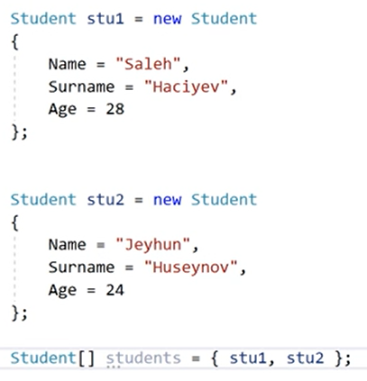
Objects and Arrays
Notes:
I+3 instead of i++

Slide 8
More
Build-in Classes
String, Math, etc.
Object Oriented Programming - OOP
Functions, Properties
IsLetter(), ToUpper(), etc.

Slide 9
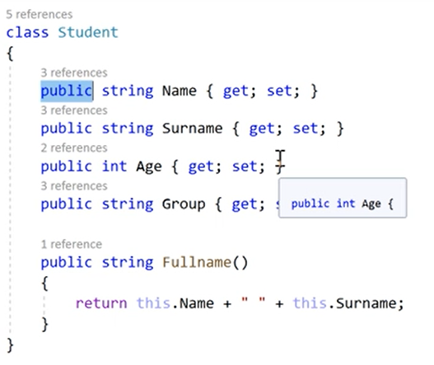
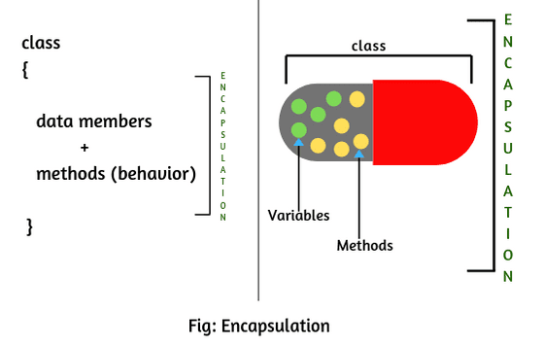
Methods and Encapsulation
Private vs Public
Methods

